Slide 1
Comparing 3D particle-counting techniques (ImageJ/Fiji and UCSF Chimera)

Slide 2
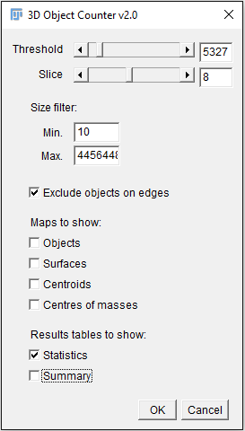
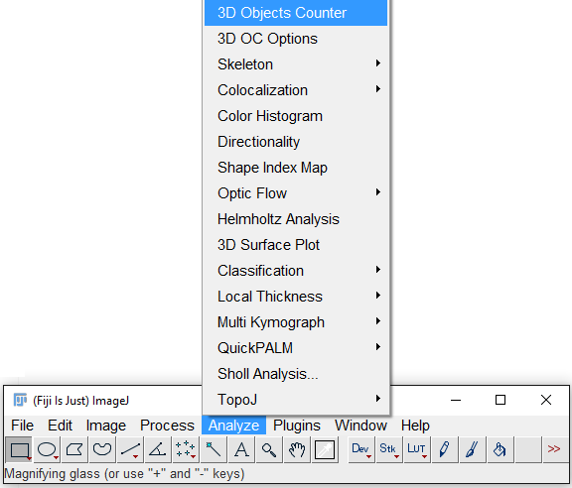
Measurement of geometrical (size, …) and optical (intensity) parameters and their statistics (+)
Interactive thresholding (+)
Constraint for particle size (+)
No (direct) visualization for correlating Table and Image (-)

Slide 3
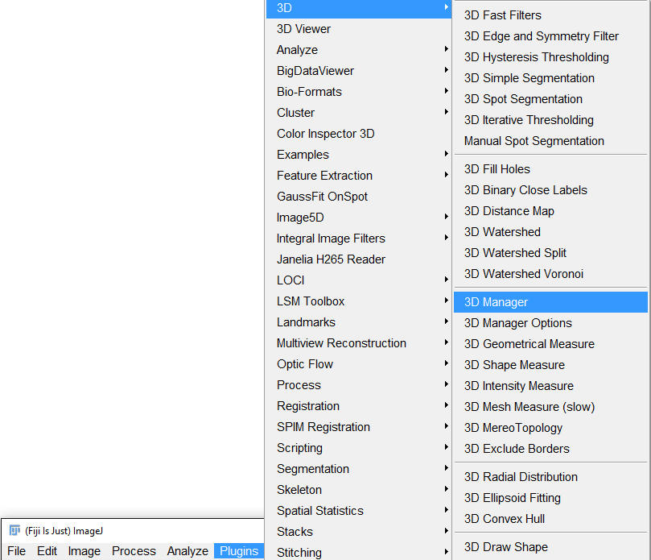
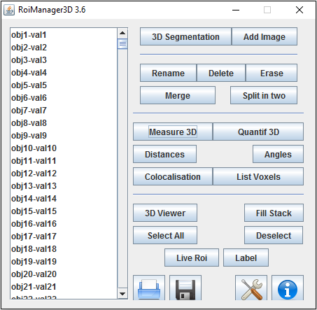
Measurement of geometrical (size, …) and optical (intensity) parameters and their statistics (+)
No interactive thresholding (-)
No constraint for particle size (-)
Direct visualization for correlating Manager and Image (+)
1
2
3

Slide 4
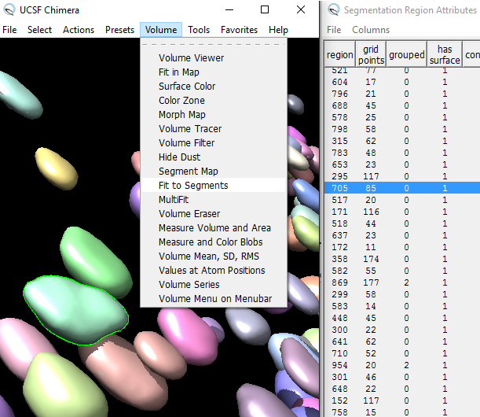
Measurement of only geometrical parameters (-)
Direct visualization for correlating Table and Image (+)
Interactive 3D visualization and selection of spots (+)
Common tool in Structural Biology (+)
Possibility of further splitting (+)
Constraint for particle size (+)
Interactive thresholding (+)
Faster than ImageJ (+)
Sortable Table (+)
8-bit TIFF images

