Slide 1
Supplementary notes to the Matlab course
Aliakbar Jafarpour
jafarpour.a.j@ieee.org
Imaging Facility, ZMBH, University of Heidelberg
February 2016

Slide 2
Quick reminder
  There is no wrong question.
    Please ask questions; one doesn’t lose face.
  Copy-pasting programs
Web browser
Cmd + A (select all)
Cmd + C (copy)
Matlab
Cmd + A (select all in an open file), or
Cmd + N (new file creation)
Cmd + V (paste)

Slide 3
Goals
What the goals are not
Complete coverage of programming concepts/tools in Matlab
Writing advanced Matlab programs
Review of the mathematics behind Matlab
Coverage of biological concepts, experiments, or data interpretation
What the goals are
Bypassing unnecessary details in an application-oriented approach
Enhancing analytical thinking and objective formulation of problems
Providing a solid background/vision for those willing to dive deeper into programming/analysis

Slide 4
The role of data analysis
Interesting
Biological knowledge
Clarity, objectivity, interest, …?
Experiment
Data
Results
Hey programmer Pal,
What do we see?
Technical knowledge
{ …, This course, …}

Slide 5
Using exercises
Running different versions
  Observation of changes from one version to the next
  Noticing the brief notes about such changes
(One’s own) Concluding notes
  Individual new commands
  Ambiguities and uncertainties
  Hypotheses and testing them
  Official documentation of the commands
  Similar commands

Slide 6



From raw (2D or 3D) data to 2D screen
Raw (2D) data
2D Screen
1
2
4
4
5
4
4
4
4
5
6
6
3
4
6
7
9
9
4
6
7
9
9
7
6
7
7
7
8
7
6
6
7
7
6
7
Raw (3D) data
Rendered data
2D Screen
1
2
4
4
5
4
Rendering
4
4
4
5
6
6
3
4
6
7
9
9
4
6
7
9
9
7
  Mapping between 2D screen (pixels) and the 3D scene (objects, illumination, …)
6
7
7
7
8
7
6
6
7
7
6
7

Slide 7
Appendix 4: Rendering
Common (surface) rendering
  Ray-casting: sending pixels to scene
  Rasterization: projecting scene to pixels (used by computer graphics cards)
  Ray-tracing: Ray-casting + accurate scene illumination (high-quality “realistic 3D”)
Volume rendering implementations
  ImageJ 3D Viewer
  X3DOM (1, 2) and Web3D Consortium
  Volume ray-casting

Slide 8
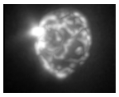
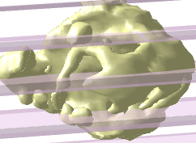
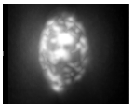
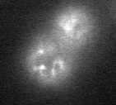
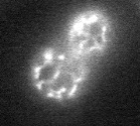
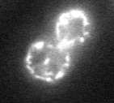
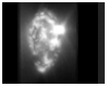


3D Imaging
  Z-stack (confocal microscopy) vs. tomographic imaging (CT scan …)
Z Stack
$"φ$ Stack” (tomograms)
y
2D Projection
=
$$φ$$
x
z
1D Rotation

Slide 9

3D data in Structural Biology
Electrons
X-ray
3D Object
“Fourier Transform”
2D Projection
2D Scattering Pattern
Key-words and references
PDB ID
Electrostatic potential
Resolution distance
Viruses with icosahedral symmetry
International Tables for Crystallography
3D Imaging Modality | Database | Visualization Program | Reconstruction Program | Measured Quantity
X-ray Crystallography | EDS (PDB) | Chimera, … | CCP4 , XDS , … | Electron density
Single-Particle Electron Microscopy (EM) | EMDB | Chimera , … | SPIDER, EMAN , … | Electrostatic potential
Takehome messages
Data: Available, free, and reliable
Visualization tool: UCSF Chimera …
Visualization results + biological interpretation: Detailed and well-documented (in associated journal papers)

Slide 10
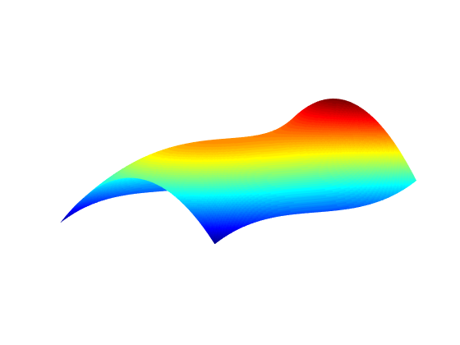
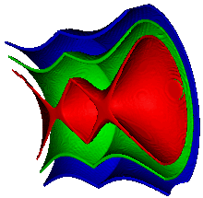
Putting “3D surface” into perspective
Contours and variation/visualization dimensions
A Line in a single confocal image
A single confocal image
A confocal z-stack
I = f₁(x)
I = f₂(x,y)
I = f₃(x,y,z)
1D Variations (2D Visualization)
2D Variations (3D Visualization)
3D Variations (in 4D Space)
I
y
Homework for volunteers!
x
“3D surface”
z
y
x
1D Variations (1D Visualization)
0D (point) contours
2D Variations (2D Visualization)
1D (curve) contours
3D Variations (3D Visualization)
2D (surface) contours
Isosurface visualization (of a z-stack)

Slide 11
Homework
Think about a (Matlab) program to analyze some of your data
Write down what you want
  With informal language
  By using biological terms
  By referring to biological background (concepts)
  By referring to biological background (people, institutions, publications)
Write down what you want
  With informal language
  Without using biological terms
  Without referring to biological background
  With very simple (not fancy) graphics
  With simple words (such as “first image”, “Intense spots”, “curve”, “object”, ….)
  (The same language that you like to be used by a [non-biologist] mathematician)

